Slide 1


Problem statement
Determine how patient demographics, clinical characteristics, and care processes affect ICU outcomes such as length of stay and mortality.
Notes:
Intro – Improving patient outcomes in the ICU is one of the highest priorities at the regional medical center.
In this presentation, I’ll walk through the insight we uncovered from analyzing ICU patient data and showing how those findings can support more effective, evidence based-decision making for both clinical and administrative leaders.
The Regional Medical Center is working to improve the quality of care in its 36-bed ICU while navigating growing pressure on resources and operational efficiency. Although clinicians rely heavily on their expertise, variation in patient outcomes suggests that deeper patterns exist within the hospital’s electronic health records. This project analyzes ICU patient data to identify the factors that most strongly influence recovery, length of stay, and resource utilization, with the goal of turning complex clinical information into insights that support evidence-based decision-making for both clinical leadership and hospital administration.
The ICU Medical Director asked our team to determine how patient demographics, clinical characteristics, and care processes shape ICU outcomes—particularly length of stay and mortality. By systematically analyzing electronic health records, our goal was to pinpoint which factors meaningfully impact patient outcomes and to offer recommendations that could improve care delivery and operational efficiency.

Slide 2
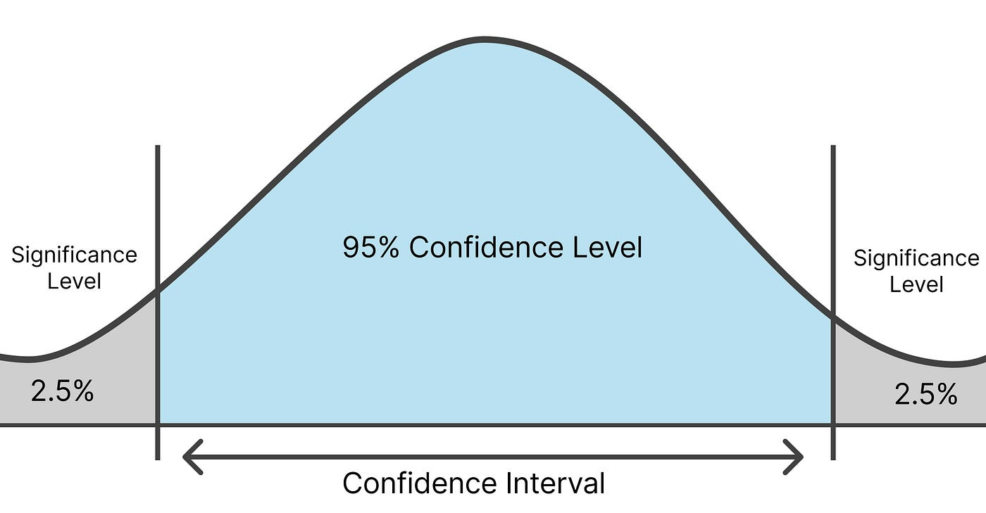
Approach
Exploratory data analysis
Regression and classification
95% confidence level
P < 0.05
Notes:
To address this, I used a structured analytical approach that combined data preparation, exploration, and statistical modeling. I consolidated multiple years of ICU electronic medical records—including demographics, diagnoses, prescriptions, and outcomes—into a unified dataset. After conducting exploratory data analysis to identify relevant patterns, I refined the dataset through cleaning, feature engineering, and dimensionality reduction to focus on the most meaningful variables. I then applied hypothesis testing and regression modeling, evaluated at a 95% confidence level, to determine which characteristics reliably predicted length of stay and mortality. Once the significant variables were identified, I translated these findings into actionable insights that could be incorporated into clinical workflows and decision-support tools.

Slide 3


Key Findings and Recommendations
Key variables
  Number of drugs administered
    Affects both LOS and Mortality
  Patients age
    Affects Mortality
Recommendations
  Age-based mortality risk wristbands
  Medication Review and recommendation system
Notes:
The analysis showed that two factors had statistically significant effects on outcomes: the number of prescriptions a patient receives and patient age. Medication count was strongly associated with both length of stay and mortality, and age was a significant predictor of mortality risk. Other variables, including number of diagnoses, did not show meaningful predictive value. Overall, medication complexity and age-related vulnerability emerged as the most reliable indicators of patient outcomes.
Based on these findings, I recommend two interventions. First, implementing age-based mortality risk wristbands to help staff quickly identify higher-risk patients and prioritize monitoring. Second, developing a medication review and recommendation system that combines pharmacist oversight with automated checks to reduce unnecessary medication complexity and flag unsafe combinations.
Together, these steps can meaningfully reduce complications, shorten length of stay, and improve overall ICU care quality.

